Slide 1

AI Bubble: Detection, Prevention, and Investment Strategies
A comprehensive guide on global AI bubble risks, sustainable investments, and strategic recommendations for policymakers and investors.
AI-Generated Presentation • Confidential

Slide 2
Executive Summary
1
2
3
4
5
Market size
Key trend
Risk factor
Investment strategy
Regulatory environment
Global AI investments reached $100B in 2022, with 55.0% growth rate
Narrative dominance and market concentration drive AI bubble risks
Compute-driven capex cycles and platform dependency exacerbate overheating
Sustainable AI investments focus on frontier models and infrastructure
EU AI Act and other regulations impact AI development and deployment
2

Slide 3

Definition
1
AI bubble refers to the overvaluation of AI companies and technologies
Introduction to the AI Bubble Concept
Causes
2
Speculative investments, hype, and lack of understanding of AI capabilities
Consequences
3
Bursting of the AI bubble could lead to significant economic losses
Implications
4
AI bubble risks impact not only investors but also the broader economy
Mitigation
5
Strategies to prevent or mitigate the AI bubble are crucial
3

Slide 4
Global AI Investment Landscape
TOTAL INVESTMENTS
GROWTH RATE
MARKET SHARE
NUMBER OF DEALS
$100B
55.0%
40.0%
1000
Total AI investments in 2022
Annual growth rate of AI investments
Share of AI investments in the US
Number of AI-related deals in 2022
4

Slide 5
Comparison of AI and Dot-Com Bubbles
AI BUBBLE
DOT-COM BUBBLE
Speculative investments: High levels of speculative investments in both AI and dot-com bubbles
Regulatory environment: Different regulatory environments for AI and dot-com bubbles
Market concentration: Concentration of market power in a few large companies
Consequences: Potential consequences of the bursting of the AI bubble
Lack of understanding: Lack of understanding of the underlying technology and its potential
Investment strategies: Different investment strategies for AI and dot-com bubbles
5

Slide 6
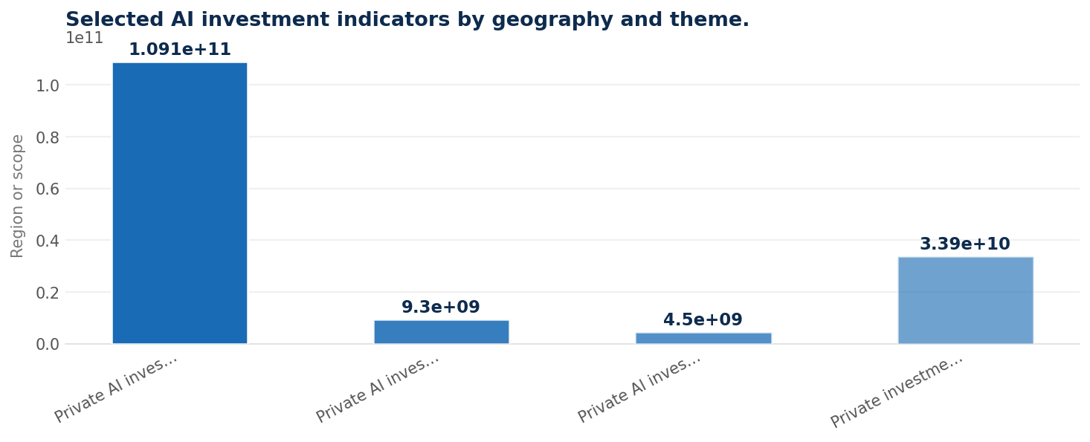
Selected AI Investment Indicators by Geography and Theme
Data visualization from document analysis
📊
6

Slide 7
Illustrative Valuation and Funding Concentration Signals in AI
MARKET SEGMENT
METRIC
VALUE (UNITS)
PERIOD
Public equities
Nvidia market capitalization
4,335,000,000,000.00 USD
January 2026
Public equities
Nvidia market capitalization
4,604,261,424,163.84 USD
January 07. 2026
Private markets
Global private AI funding
100,400,000,000.00 USD
2024
Private markets
Global private AI funding
225,800,000,000.00 USD
2025
4 records · 4 metrics · Source: Document Analysis
7

Slide 8
Investor Risk Assessment Framework
01
02
03
04
Risk assessment
Risk mitigation
Investment strategy
Monitoring
Identify potential risks and their likelihood
Develop strategies to mitigate identified risks
Adjust investment strategy based on risk assessment
Continuously monitor and update risk assessment and investment strategy
8

Slide 9

Long-term approach
1
Focus on long-term growth and sustainability
Sustainable AI Investment Principles
Diversification
2
Diversify investments to minimize risk
ESG considerations
3
Consider environmental, social, and governance factors
Active engagement
4
Engage with companies to promote sustainable practices
Monitoring
5
Continuously monitor and evaluate investment portfolio
9

Slide 10

AI Bubble Burst Could Lead to 69.000% Losses
Losses: Potential losses of 69.000% in the event of an AI bubble burst
Risk: High risk of significant economic losses
Mitigation: Strategies to mitigate potential losses
Investment strategy: Adjust investment strategy to minimize potential losses
10

Slide 11

Conclusion
→
AI bubble risks: Potential risks and consequences of the AI bubble
→
Investment strategies: Strategies to mitigate potential losses
→
Regulatory environment: Importance of regulatory environment in AI development
→
Sustainable investments: Principles for sustainable AI investments
→
Monitoring: Continuously monitor and evaluate investment portfolio
11

Slide 12
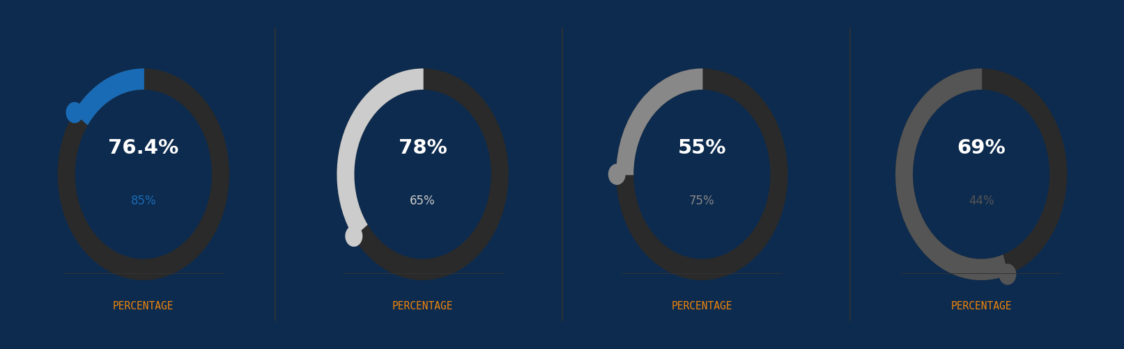
Key Metrics for AI Investments
12

Slide 13
Strategic Recommendations
→
Investor strategy: Diversify investments to minimize risk
→
Regulatory environment: Promote regulatory environment that supports AI development
→
Sustainable investments: Focus on sustainable AI investments
→
Monitoring: Continuously monitor and evaluate investment portfolio
13

